Slide 1
BASIC COMP. ARCHITECTURE Bachelor of Computer Science (Hons) (Network Technology and Cybersecurity) MODULE CODE: BCA114

Slide 2
CLO 3
High Level Language

Slide 3


Slide 4


Slide 5


Slide 6
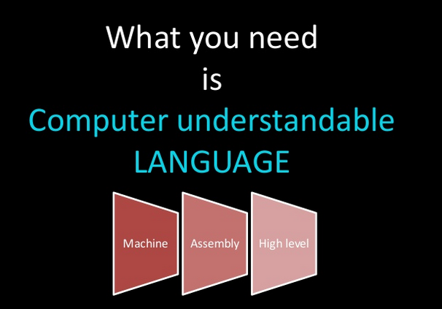

Slide 7
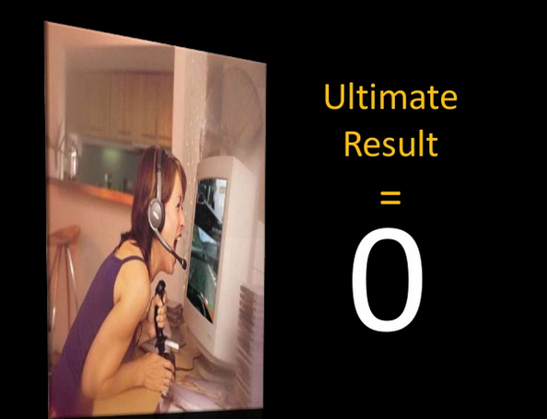

Slide 8
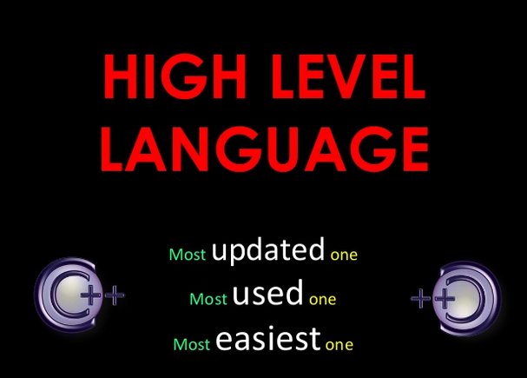
CLO 3
High Level Language

Slide 9
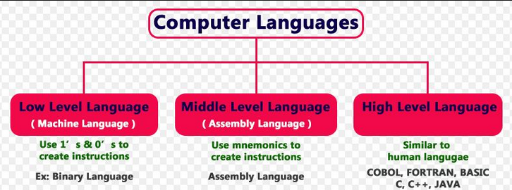
CLO 3
High Level Language

Slide 10
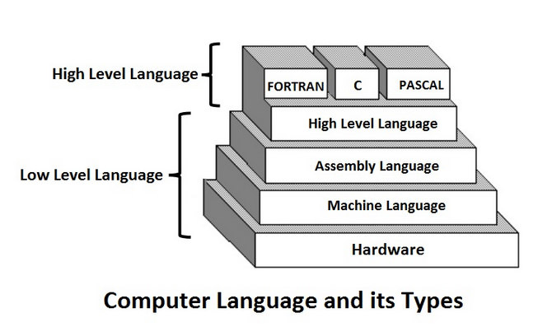
CLO 3
High Level Language

Slide 11
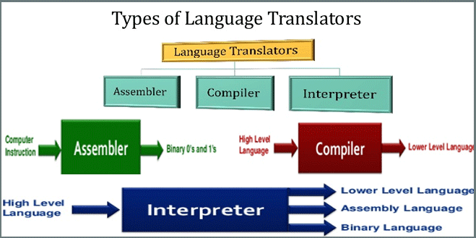
CLO 3
High Level Language

Slide 12
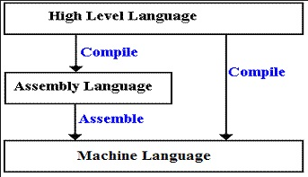
CLO 3
High Level Language

Slide 13
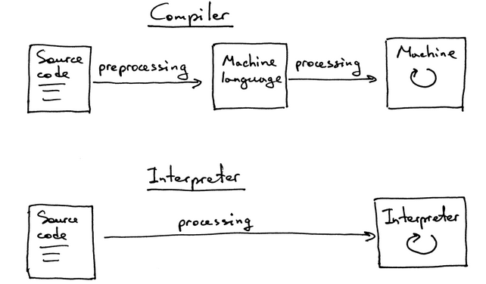
CLO 3
High Level Language

Slide 14
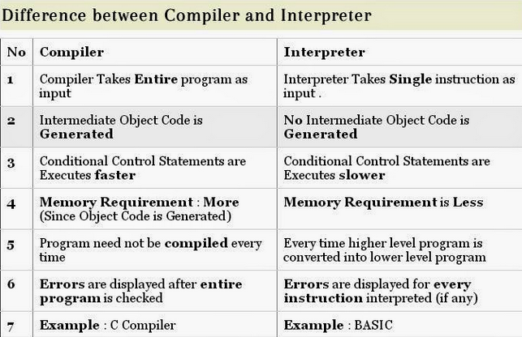
CLO 3
High Level Language

Slide 15
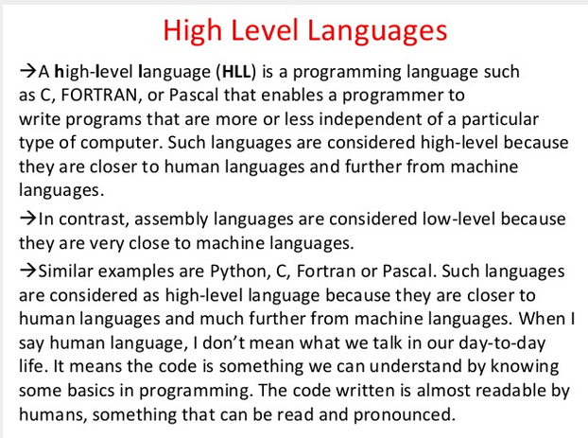
CLO 3
High Level Language

Slide 16
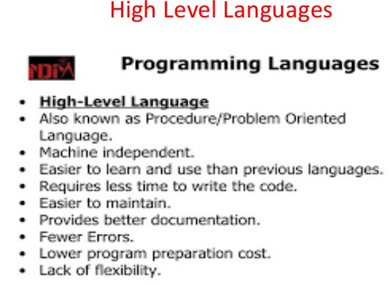
CLO 3
High Level Language

Slide 17
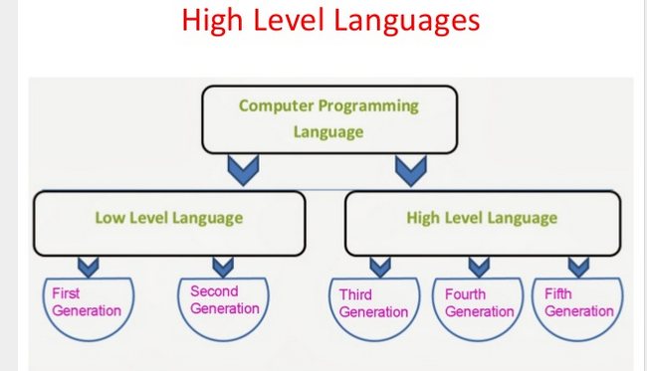
CLO 3
High Level Language

Slide 18
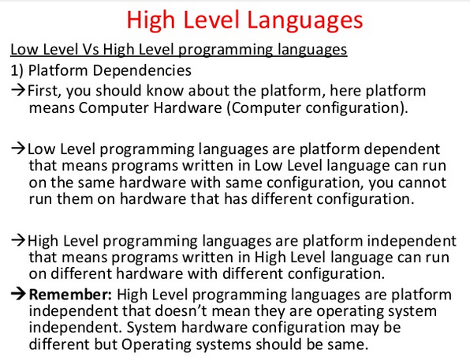
CLO 3
High Level Language

Slide 19
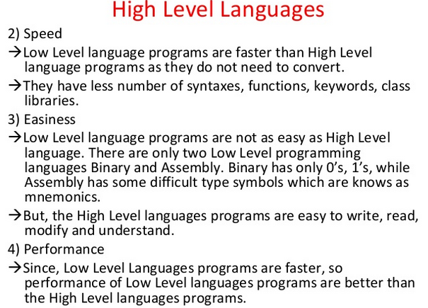
CLO 3
High Level Language

Slide 20
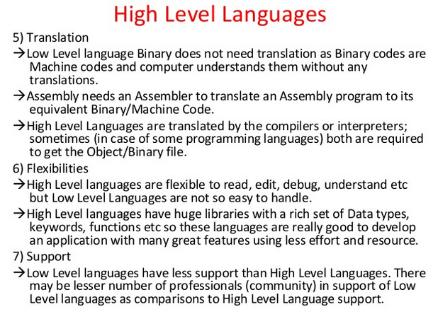
CLO 3
High Level Language

Slide 21
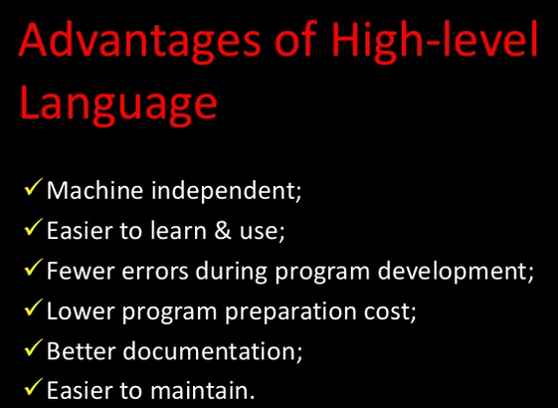
CLO 3
High Level Language

Slide 22
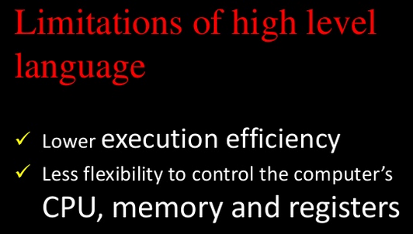
CLO 3
High Level Language

Slide 23
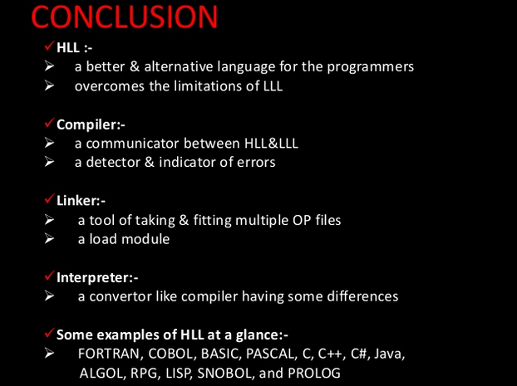
CLO 3
High Level Language

